Slide 1
VB.Net - ListBox Control
Prof. Neeraj Bhargava
Kapil Chauhan
Department of Computer Science
School of Engineering & Systems Sciences
MDS University, Ajmer

Slide 2
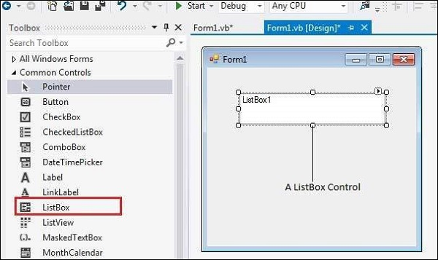
VB.Net - ListBox Control

Slide 3
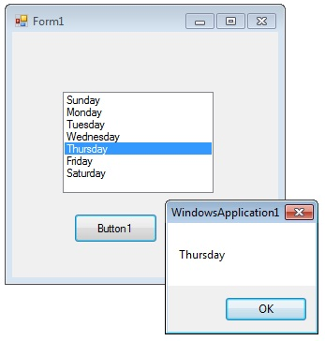
Cont…
The ListBox represents a Windows control to display a list of items to a user.
A user can select an item from the list. It allows the programmer to add items at design time by using the properties window or at the runtime.

Slide 4
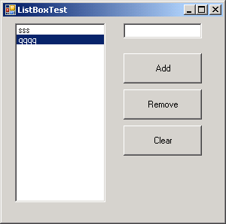
Cont..
You can use the Add or Insert method to add items to a list box.
The Add method adds new items at the end of an unsorted list box.
The Insert method allows you to specify where to insert the item you are adding.

Slide 5
Properties of the ListBox Control
1AllowSelection
Gets a value indicating whether the ListBox currently enables selection of list items.
2BorderStyle
Gets or sets the type of border drawn around the list box.
3ColumnWidth
Gets of sets the width of columns in a multicolumn list box.
4HorizontalExtent
Gets or sets the horizontal scrolling area of a list box.

Slide 6
Cont..
5. ItemHeight
Gets or sets the height of an item in the list box
6. Items
Gets the items of the list box.
7. MultiColumn
Gets or sets a value indicating whether the list box supports multiple columns.
8. SelectedIndex
Gets or sets the zero-based index of the currently selected item in a list box.
9.SelectedValue
Gets or sets the value of the member property specified by the ValueMember property
10. Sorted
Gets or sets a value indicating whether the items in the list box are sorted alphabetically.

Slide 7
Events of the ListBox Control
1. ClickOccurs
when a list box is selected.
2. SelectedIndexChanged
Occurs when the SelectedIndex property of a list box is changed

Slide 8
Assignment
Explain all the methods and events of Listbox in vb.net with example.

